Slide 1
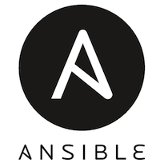
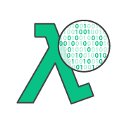

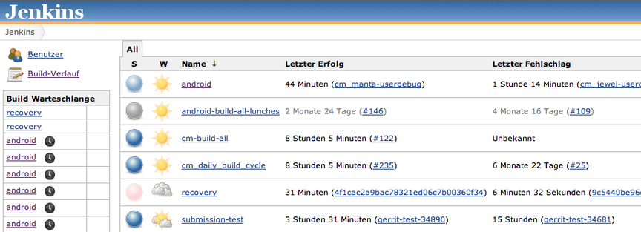
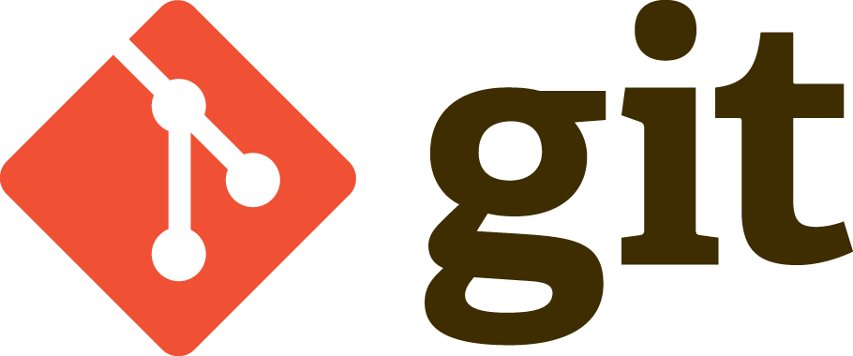
Cloud Automation Tools

Slide 2
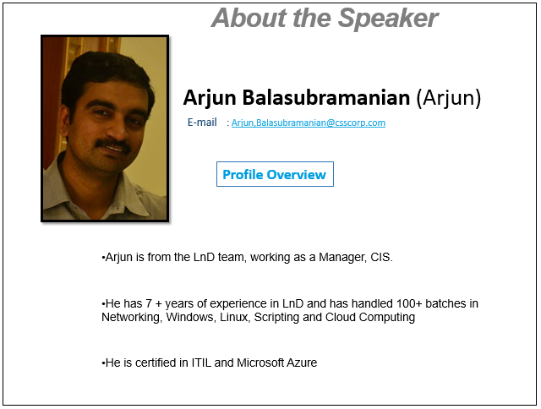

Slide 3

Why Automate
As Cloud Infrastructure becomes more complex, they become more difficult to manage
Recreating the infrastructure becomes impossible without proper standards in place
Challenges around scalability into the cloud
Quicker timelines when implementing major changes

Slide 4
Examples of Cloud Automation
Automating the backup of AWS Snapshots using DynamoDB and AWS Lambda
Deploy multiple heterogeneous cloud instances with Terraform and Ansible
Apply only the missing patches in multiple clusters of Windows Servers using Azure Automation
Scale in/out or Scale up/down the cloud resources using triggers that detect user activity with the help of monitoring tools like Cloudwatch
Build, test and deploy an update automatically using CI/CD with tools like Jenkins

Slide 5
Categories of Cloud Automation
Infrastructure automation: Infrastructure is structured and built into templates, where it can be versioned and easily replicated for future environments.
Tools: AWS CloudFormation, GitHub, Azure Resource templates and DSC, Terraform
Deployment automation: Code deployment processes are integrated with cloud-native tools, improving deployment velocity and reducing manual effort (and error).
Tools: Ansible, AWS CodeDeploy, AWS Lambda, Puppet, Chef, Jenkins, Azure Automation
Self-healing/auto-correcting/self-monitoring: Configuration management scripts and monitoring tools catch anomalies and proactively correct failed/misconfigured resources.
Tools: AWS Lambda, Ansible, Puppet, Chef, Jenkins, Azure Automation,

Slide 6
IaC – Infrastructure as Code
Infrastructure as code (IaC) is the process of managing and provisioning computer data centers through machine-readable definition files, rather than physical hardware configuration or interactive configuration tools.
There are generally three approaches to IaC:
declarative (functional)
imperative (procedural)
intelligent (environment aware)
The difference between the declarative, the imperative and the intelligent approach is essentially 'what' versus 'how' versus 'why' .

Slide 7
IaC – Infrastructure as Code
Declarative
Focuses on eventual target configuration
Defines the desired state and the system executes what needs to happen to achieve that desired state.
Imperative
How to infrastructure must be changed to meet the an eventual configuration
Defines specific commands that need to be executed in the appropriate order to end with the desired conclusion
Intelligent
Why the configuration should be a certain way in consideration of all the co-relationships and co-dependencies of multiple applications running on the same infrastructure typically found in production.

Slide 8
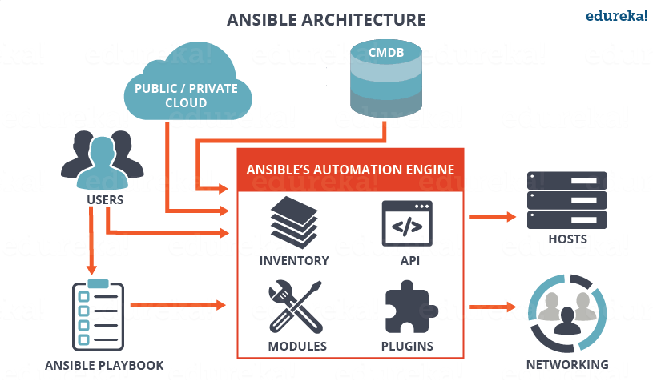
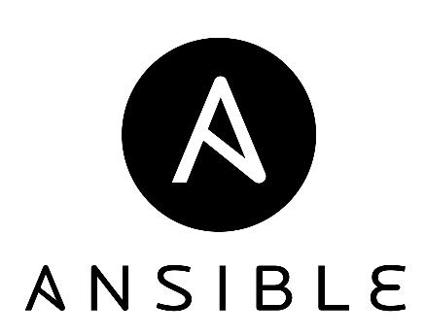
Configuration Management

Slide 9
Ansible
Architecture
As with most configuration management software, Ansible has two types of servers: controlling machines and nodes. First, there is a single controlling machine which is where orchestration begins. Nodes are managed by a controlling machine over SSH. The controlling machine describes the location of nodes through its inventory.
To orchestrate nodes, Ansible deploys modules to nodes over SSH.
In contrast with popular configuration management software — such as Chef and Puppet — Ansible uses an agentless architecture. With an agent-based architecture, nodes must have a locally installed daemon that communicates with a controlling machine.

Slide 10
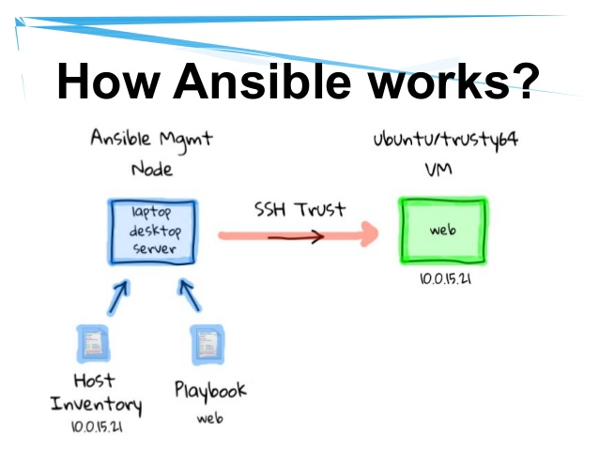
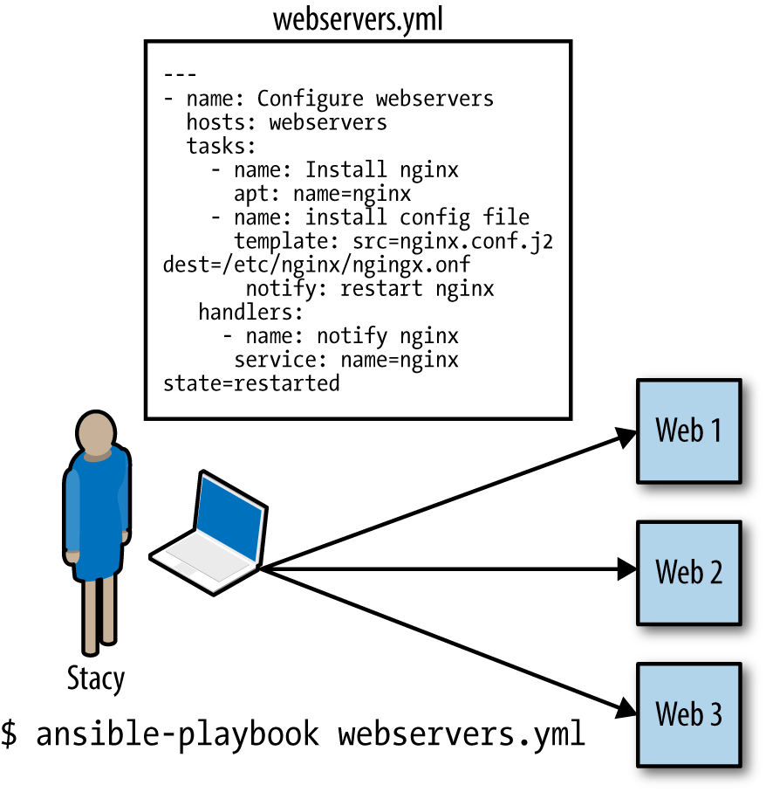
Ansible

Slide 11
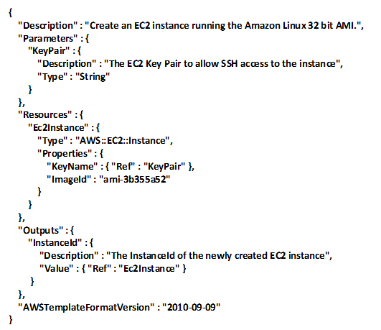
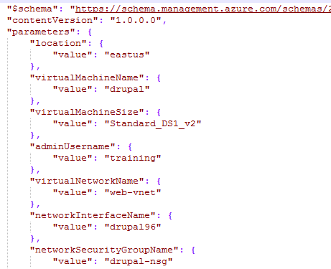
Templates in JSON
AWS Cloudformation/Azure Resource Templates allows us to describe infrastructure as a json file, which we can then apply to a service, like AWS VPC or Azure Resource Groups

Slide 12
Disadvantages of JSON
Json is not a great way to code
Files can get very large
Hard to know what’s been applied to an environment

Slide 13
Other Configuration Management Tools
Chef
Puppet
AWS Cloudformation
Azure DSC
Terraform

Slide 14
Comparing the IaC tools
Configuration Management vs Orchestration
Chef, Puppet, Ansible, and SaltStack are all “configuration management” tools, which means they are designed to install and manage software on existing servers
CloudFormation and Terraform are “orchestration tools”, which means they are designed to provision the servers themselves, leaving the job of configuring those servers to other tools.
Procedural vs Declarative
Chef and Ansible encourage a procedural style where you write code that specifies, step-by-step, how to to achieve some desired end state.
Terraform, CloudFormation, SaltStack, and Puppet all encourage a more declarative style where you write code that specifies your desired end state, and the IAC tool itself is responsible for figuring out how to achieve that state.

Slide 15
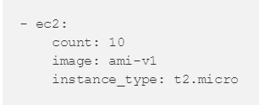
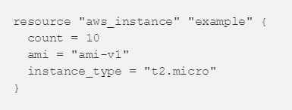
Comparing the IaC tools
For example, let’s say you wanted to deploy 10 servers (“EC2 Instances” in AWS lingo) to run v1 of an app. Here is a simplified example of an Ansible template that does this with a procedural approach:
And here is a simplified example of a Terraform template that does the same thing using a declarative approach:
Becomes 5 to add 5 more instances
Becomes 15 to add 5 more instance

Slide 16
Comparing the IaC tools
Client/Server Architecture vs Client-Only Architecture
Chef, Puppet, and SaltStack all use a client/server architecture by default.
The client, which could be a web UI or a CLI tool, is what you use to issue commands (e.g “deploy X”).
Those commands go to a server, which is responsible for executing your commands and storing the state of the system.
To execute those commands, the server talks to agents, which must be running on every server you want to configure.
Ansible, and Terraform, use a client-only architecture.
The Ansible client works by connecting directly to your servers over SSH.
Terraform uses cloud provider APIs to provision infrastructure, so there are no new authentication mechanisms beyond what you’re using with the cloud provider already, and there is no need for direct access to your servers.

Slide 17
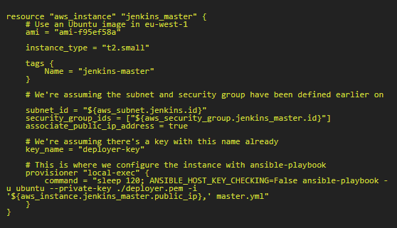
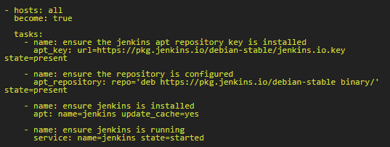
Use Case – Using Terraform with Ansible
Terraform is a great tool for building infrastructure in the cloud. Ansible is a beautifully simple agentless (and serverless) configuration management tool. A common use case is to build servers with Terraform, and have Ansible configure them.
Following example is a Terraform specification for Jenkins Master Server in AWS EC2 and the accompanying ansible playbook

Slide 18
Automate Tasks
While tools like Ansible, Terraform excel in setting up the environments with the desired configuration, tools like AWS Lambda, Azure Functions and Automation integrated in the their respective loud environments are more suited to handle deployment tasks based on more specific conditions.
Serverless computing is a cloud computing execution model in which the cloud provider dynamically manages the allocation of machine resources.

Slide 19
Automate Tasks
AWS Lambda
AWS Lambda is a compute service that lets you run code without provisioning or managing servers.
You can use AWS Lambda to run your code in response to events, such as
changes to data in an Amazon S3 bucket or an Amazon DynamoDB table;
to run your code in response to HTTP requests using Amazon API Gateway; or
invoke your code using API calls made using AWS SDKs.
AWS Lambda is an ideal compute platform for many application scenarios, provided that you can write your application code in languages supported by AWS Lambda (that is, Node.js, Java, C# and Python), and run within the AWS Lambda standard runtime environment and resources provided by Lambda.

Slide 20
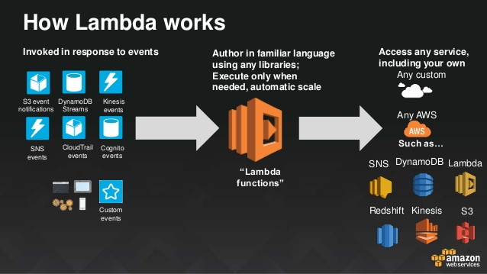
AWS Lambda

Slide 21
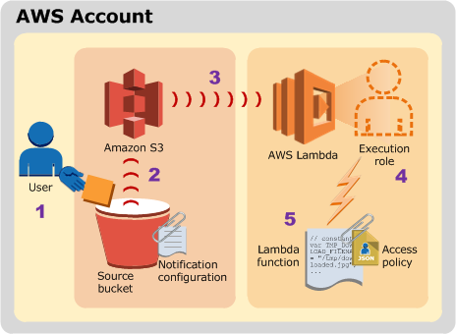
Automate Tasks
AWS Lambda Use Case
Using AWS Lambda with Amazon S3
Amazon S3 can publish events (for example, when an object is created in a bucket) to AWS Lambda and invoke your Lambda function by passing the event data as a parameter. This integration enables you to write Lambda functions that process Amazon S3 events

Slide 22
Automate Tasks
AWS Lambda Use Case
User uploads an object to an S3 bucket (object-created event).
Amazon S3 detects the object-created event.
Amazon S3 invokes a Lambda function that is specified in the bucket notification configuration.
AWS Lambda executes the Lambda function by assuming the execution role that you specified at the time you created the Lambda function.
The Lambda function executes.

Slide 23
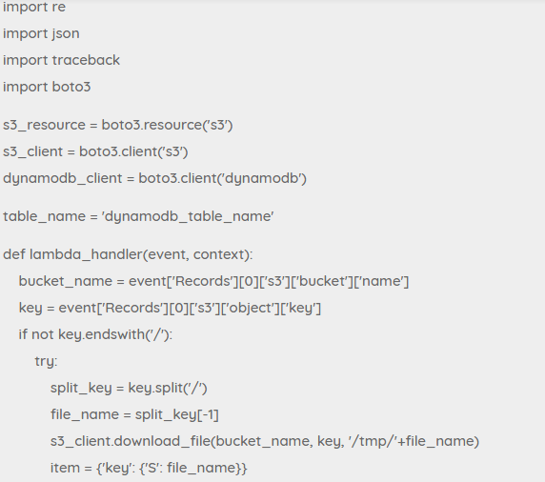
Automate Tasks
AWS Lambda Use Case – Get and item from S3 to process

Slide 24
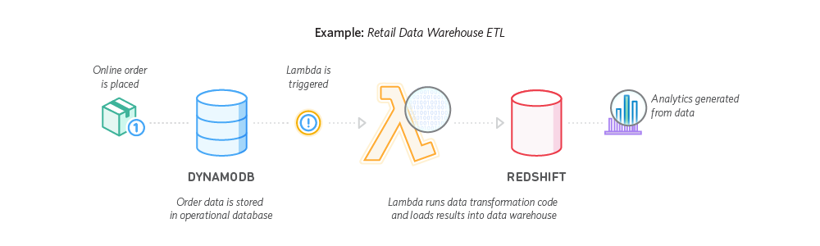
Real-Time use case of AWS Lambda

Slide 25
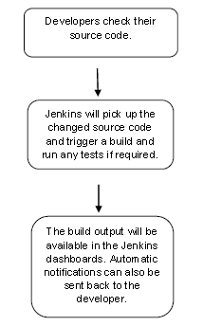
Deployment using CI
Jenkins
Jenkins is a software that allows continuous integration. Jenkins will be installed on a server where the central build will take place. The following flowchart demonstrates a very simple workflow of how Jenkins works.

Slide 26
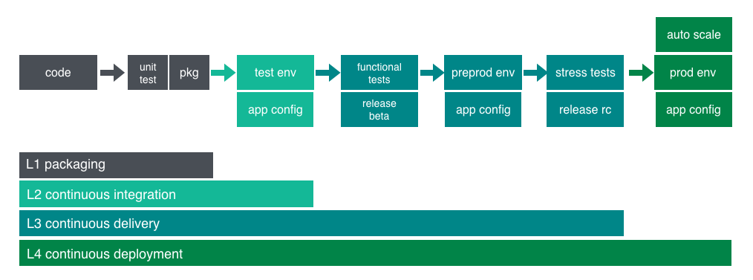
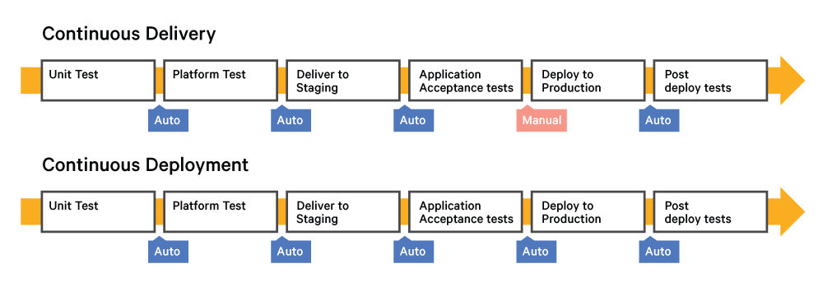
Continuous Delivery pipeline

Slide 27
Other tools used in CI/CD
Maven for Build Servers
Codepipeline in AWS
CI Tools
Jenkins
Bamboo
TeamCity
Travis CI
Using Configuration Management tools for deployment/delivery

Slide 28
Cloud Automation – more to it
Using Containers
Adopting customized microservices such as containers reduces the need to use full fledged Operating Systems to deploy applications. Configuration Management tools may not be required when using containers.
Using Environment aware intelligent orchestration tools that configure the cloud resources according to desired states arrived at own their own rather than configuring them manually
Automatic report generation, using monitoring tools like AWS Cloudwatch to trigger events, based on alarms, that change the configuration of AWS EC2 instances

Slide 29
Thank you
You can reach me @Arjun.Balasubramanian@csscorp.com

